Slide 1
Google Translate
Google Translate (JavaScript (React.js (Next.js)), Html5, CSS(Tailwind CSS), Microsoft Azure, Cosmos DB(MongoDB(Mongoose)), Clerk Authentication).

Slide 2
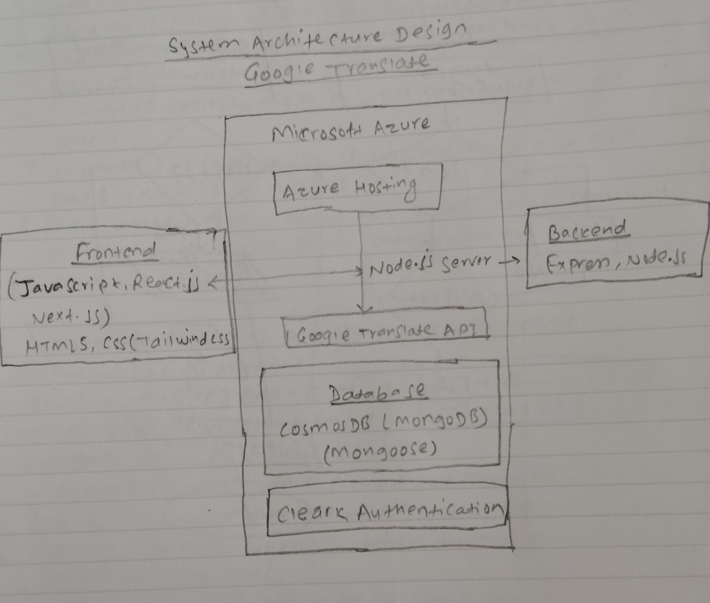
System Architecture Design

Slide 3
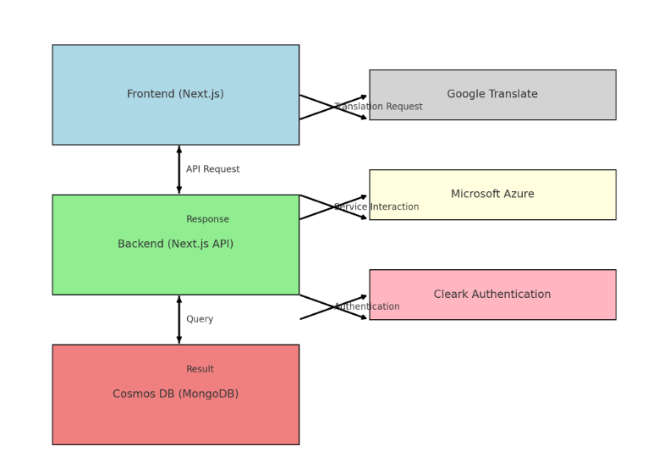

Slide 4
The design model of Google Translator app illustrates interactions among various components that are incorporated using many latest technologies/tools.
1. User interacts with the Frontend. (JavaScript, (React.js, (Next.js))), HTML5, CSS(tailwind CSS)
2. Frontend sends a translation request to the Backend.(Express, Node.js)
3. Backend processes the request, calling the Google Translate API. Using Microsoft Azure Language Translation.
4. Backend stores the translation in Cosmos DB.(Mongo DB)
5. Authentication Middleware ensures secure access.(Clerk)
6. Backend responds with the translation.
7. Frontend displays the translated text to the user.

Slide 5
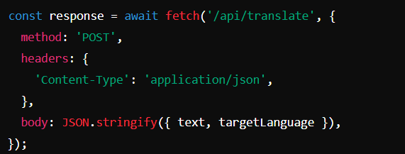
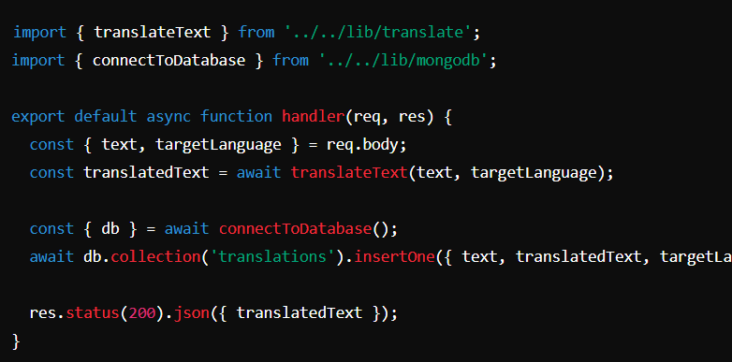
The user interacts with the web application through the UI, filling out input forms and requesting translations.
When the user submits the translation form, the frontend sends an API request to the backend.
The Backend receives the request, process it, and interacts with various services.

Slide 6
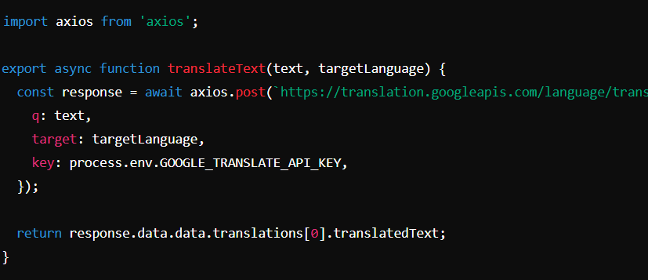
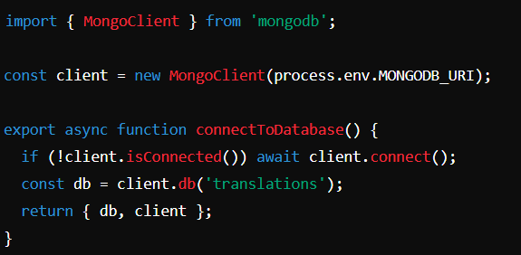

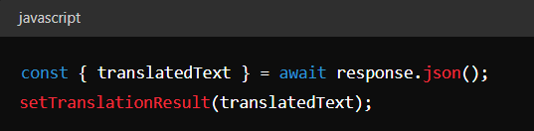
4. The backend calls the Google Translate API to get the translation.
5. The backend stores the original and translated text in the Cosmos DB.
6. The middleware handles user authentication and authorization.
7. The backend sends the translated text back to the frontend.
8. The frontend receives the translated text and displays it to the user.

Slide 7
Components:
Frontend:
Technologies: React.js (Next.js), HTML5, CSS (Tailwind CSS)
Features: User Interface, Input Forms, Display Translations
Interactions: Sends translation requests to Backend, Handles user authentication via Clerk.
Sends user inputs to Backend API.
Displays results returned by Backend.
Manages user sessions with clerk Authentication.

Slide 8
Backend:
Technologies: Next.js API routes
Features: API Endpoints, Middleware, Request Handling
Interactions: Receives requests from Frontend, processes translations via Google Translate API, interacts with Database
Process translation requests
Calls Google Translate Api
Queries and updates Database
Integrates with Microsoft Azure for various services

Slide 9
Google Translate:
API Integration: JavaScript client for translations
Role: Provides translation services for user input
Receives text for translation

Slide 10
Microsoft Azure:
Services: Hosting, Functions, Storage
Role: Provides cloud infrastructure and services

Slide 11
Database:
Technologies: Cosmos DB with MongoDB (Mongoose)
Role: Stores user data, translation history, authentication tokens
Interactions: Queried by Backend for data retrieval and storage
Stores user information, translation data
Retrieves data upon Backend request

Slide 12
Authentication:
Provider: Clerk Authentication
Role: User authentication and authorization
Interactions: Verifies user credentials, provides tokens for secure API access
Verifies user identities
Issues authentication tokens for session management

Slide 13
Thank you ☺
Gaire Ananta Prasad M24W0272

